Slide 1
Software Quality Assurance

Slide 2
What is Software Quality Assurance?

Slide 3
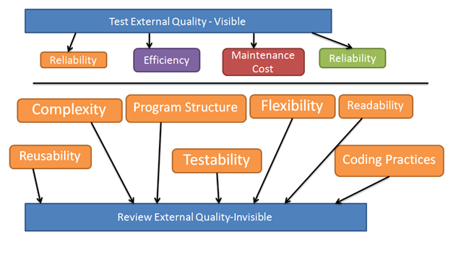
Software Quality

Slide 4
Requirements
Real business requirements
Design
Conformance
Performance
System requirements

Slide 5
International Organisation for Standardisation (ISO)

Slide 6
ISO 9000
ISO 9001:2015 - Quality Management Systems: Requirements
ISO 9000:2015 - Quality Management Systems: Fundamentals and Vocabulary
ISO 9004:2009 - Quality Management Systems: Guidelines for Performance Improvements
ISO 19011:2011 - Guidelines for auditing management systems

Slide 7
Case Study 2
International Office Equipment Group Maintenance Accounts
International Office Equipment (IOE) is a company which manufactures and supplies various items of high-technology office equipment. An expanding area of their work is the maintenance of ICT equipment. They have now started to undertake maintenance of equipment for which they were not originally the suppliers. A computer-based batch processing system deals with invoicing on a job-by-job basis. An organization might have to call IOE out several times to deal with different bits of equipment and there is a need to be able to group the invoice details for work done into “group accounts” for which monthly statements will be produced. A new project manager has been given the task of implementing this extension to the invoicing system.

Slide 8
Thanks for listening Any questions?

